Slide 1
New Product Development: Research Tips & Active Listening
ENGR 1080 / McCall
Orig. 1/31/2018, Rev. 2/10/2019
Courtesy of University of Detroit Mercy – Fall 2019
Notes:
Re: New Product Development. “For more than 40 years, the NASA Innovative Partnerships Program has facilitated the transfer of NASA technology to the private sector, benefiting global competition and the economy. The resulting commercialization has contributed to the development of commercial products and services in the fields of health and medicine, industry, consumer goods, transportation, public safety, computer technology, and environmental resources. Since 1976, Spinoff has featured over 1,600 of these commercial products” (NASA, 2008).
NASA, which has its own Technology Roadmap, has lots of practice in developing technology and has added millions of dollars to the U.S. economy. Other product engineers can learn from them.

Slide 2
Why do we research?
Recap
Accuracy: Search for facts and expert opinion.
Credibility: So we can make better decisions.
Efficiency: And save time by using the work already done.
Workability: Plus we learn to develop realistic expectations for our inventions.
Notes:
Research will be a part of our professional worklife.
Everything we do at work is rooted – somehow – in what came before us. We need to know the past so we do not repeat it.
We also need to know the past so that our new ideas fit into a continuum of thought and practice. Even our revolutionary ideas are based on ideas that came before.
Knowing the past and being able to refer to it sensibly adds to our credibility as an author and as a presenter.

Slide 3
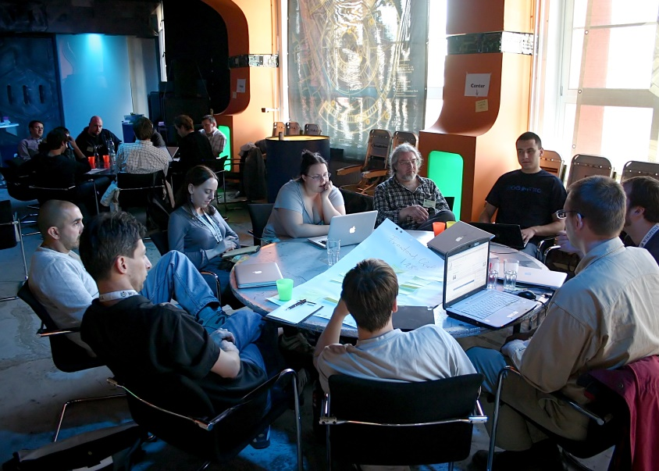
1. Secondary Research: – Others have done it (already published research). – Learn from what others have done. 2. Primary Research: – You do it. – Customize a general approach to a particular situation.
Recap
Primary vs. Secondary Research:
Purpose and Sequence
Notes:
- This slide reminds us of the value of different kinds of research.

Slide 4
How Big Is the Market?
Market Research
Recap
Source: Do add a credit line here.
Consumer Trends
Source: Do add a credit line here.
Notes:
Much of the research we present in the workplace will be in the form of graphics.
We need to cite sources, anchor the data with a date and place (ex., In the United States in 2018, 5 M people…” and clear titles that engage the reader.

Slide 5
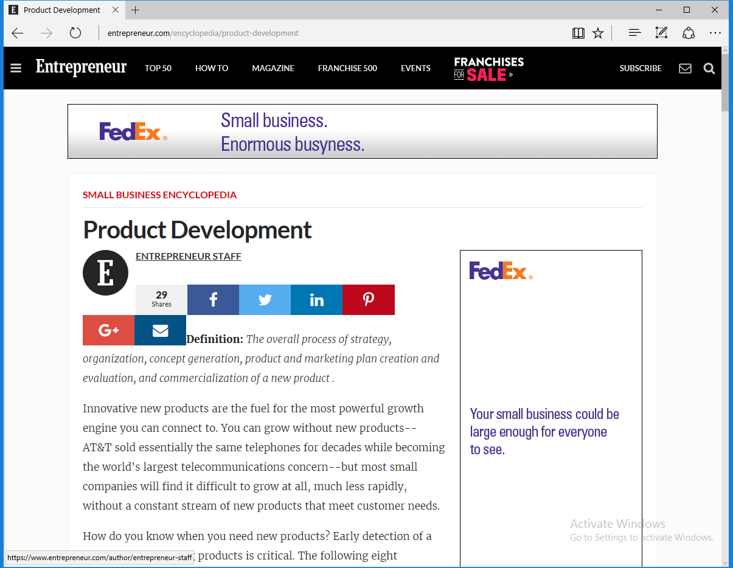
Secondary Research Tools: How to introduce new products
Notes:
You will be looking beyond the scholarly databases (the library research) you have used to date.
You need to educate yourself about the product development process and the tools it uses.
That’s why you’re in ENGR 1080 – to learn how to bring to market the products you will invent.

Slide 6
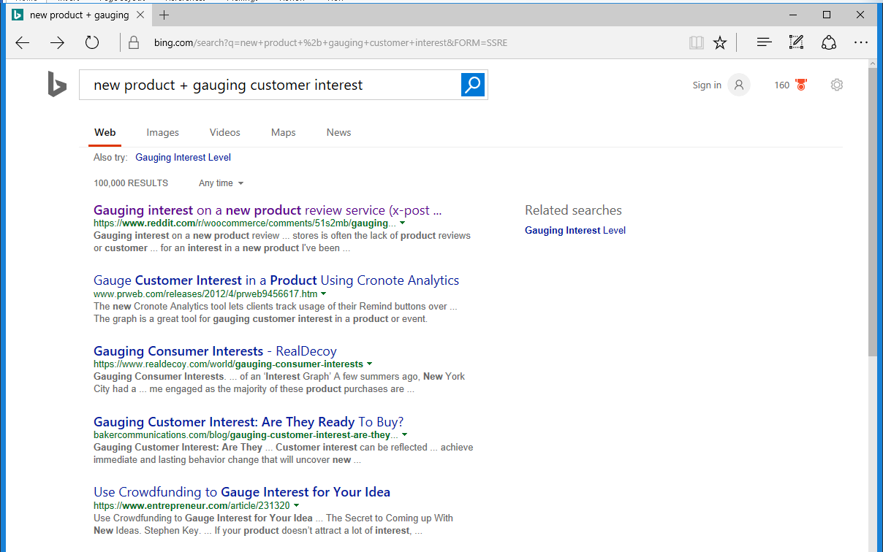
Primary Research Tools: ex., Customer Surveys
Notes:
Here we see a primary tools that support the Product Development process. We must start with the customer and learn him or her. In this way, we learn about the size of the market and what it wants.
While surveys can collect large amounts of information, they are not useful for finding out what customers are thinking in a more profound way. We need to match the primary research methods to the depth of response desired.

Slide 7
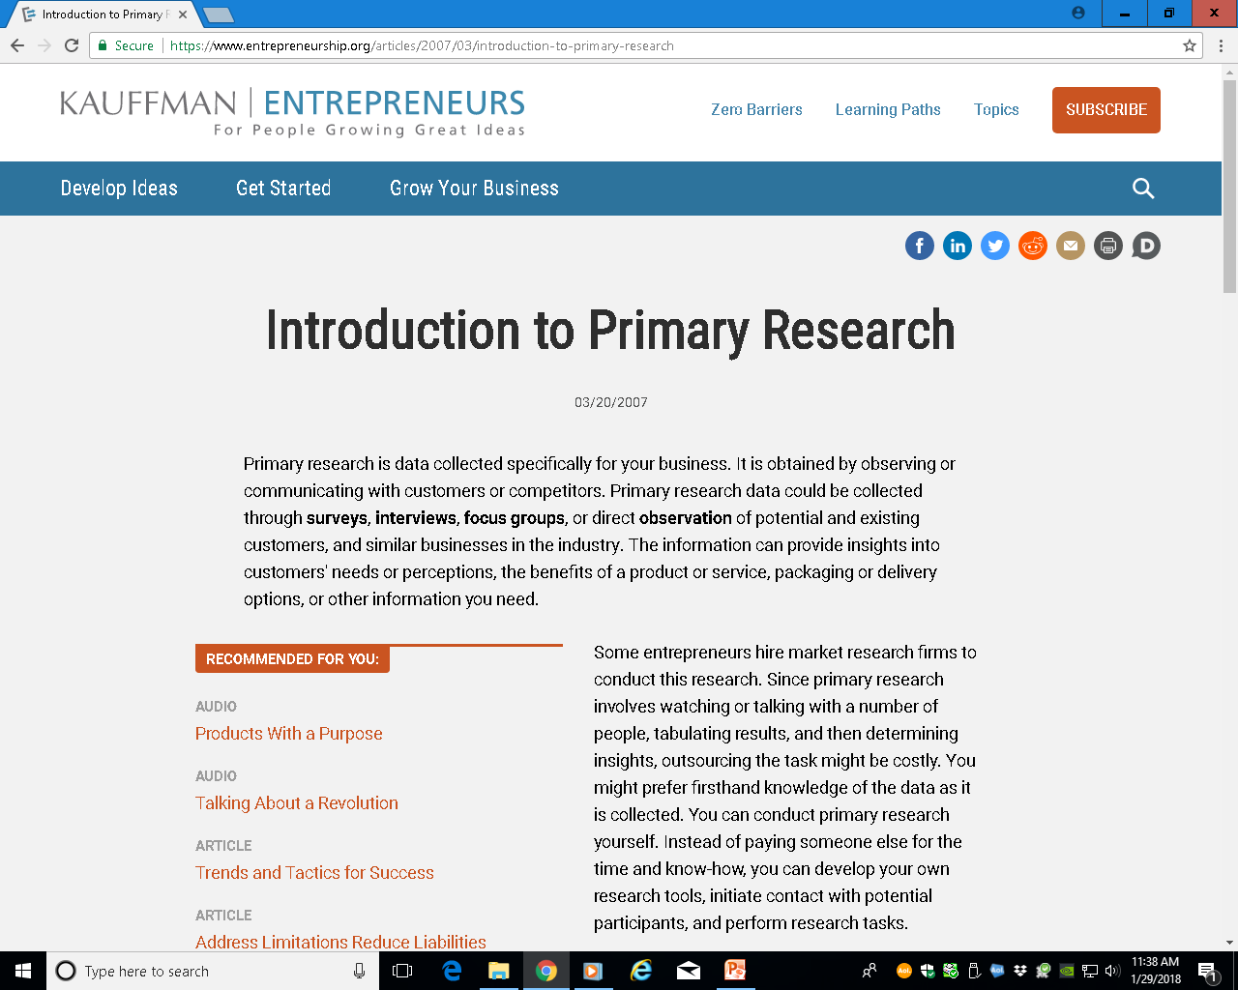
Primary Research Tools: ex., Talking and Listening to Customers
Notes:
Talking to customers takes many forms, as you can see in this Introduction by Kauffman Entrepreneurs. Surveys, interviews, focus groups and direct observation are all useful tools to collect information about our potential customers.
In this class, we’ll be focusing on Customer Interviews to help us learn about what customers want. Then we will know whether they’ll be interested in our technology.
This process flips the approach. Typically, we think of a product and try to sell it (remember the multi-tool?). Now we will interview the customer and build a technology or service around what they say they want and need.

Slide 8
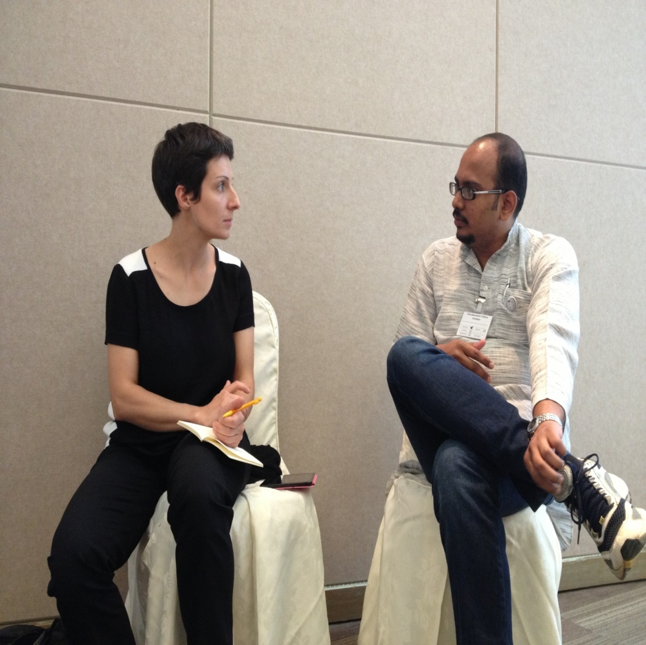
Value: Active Listening
Customer Interviews
Active Listening:
Person talking heard, understood
Person listening accurate information
Cust. Discovery via Research
Notes:
- So how do we go about talking with customers? How do we have genuine conversations that reveal usable information about them?
A fallacy we often operate by is that listening is a passive activity. It is not (Alred et al , 2014, pp. 233-234).
Active listening is yet another tool we can use to reach our bosses, our co-workers – and with our customers.
- When we feel heard and understood, we become more engaged in our work and our relationships with co-workers. The end result is a better work process for everyone involved. In the same way, we can really put ourselves in our customers’ shoes and understand their needs (this is called empathy).

Slide 9
Helpful in the Workplace
Customer Inteviews
Active Listening:
Value
Fewer errors
Less wasted time
Enhanced problem solving
Customer needs/interests understood better
Notes:
- Albert Mehrabian, a famous psychologist/professor, said that we communicate in three ways: Through words (7%), through vocals such as tone of voice and volume (38%), and body language (55%) (facial expressions, posture, movements). To really hear someone, we have to pay attention to all three means of communication (Inst. Of Judicial Studies, “Communication Studies” (2013).
- According to an article in Forbes magazine, active listening can help us avoid problems with co-workers and, when problems do occur, we can resolve them more quickly (Clark, 2012). The same principle applies to hearing customers and their needs, wishes and complaints.

Slide 10
Active Listening: How To’s
Do’s
Paraphrase
Probe
Ask open-ended questions
Use transitions
Be descriptive
Notes:
Paraphrasing is using our own words to repeat what the speaker has said. Ex., “Let’s see if I heard you correctly…”
Probing is asking questions like: “Can you tell me more about that?” “I’m not sure I understood your last point…”
Open-Ended Questions encourage the speaker to say more than Yes or No. You learn through hearing the details. Ex. Would you buy my smart refrigerator? Or What features would you like to see in a new refrigerator? Or What issues are you having with prescription delivery?
Transitions build bridges between ideas. Instead of an interrogation, you have a conversation. Ex., So you’d like to see a smart thermostat in your house, but you’re worried about the cost. Or You are worried your small children will have easy access to your medications.
Descriptions are simple word pictures. Evaluations or judgments are your feelings about a person or his/her behavior. Ex., When you arrive late to the meeting, we spend time repeating issues you need to hear about vs. Your rudeness in coming late all the time puts us behind schedule. Which one would you listen to? (Alred et al (2013) and Inst. of Judicial Studies, “Active Listening” (2013).

Slide 11
Active Listening: How To’s
Active Listening: How To’s
Don’ts
Interrupt
Get distracted
Offer solutions
Judge/evaluate
Notes:
We don’t interrupt because that tells the speaker we are focusing more on our ideas than theirs.
Distractions include wondering when the speaker will stop so you can make your own point. Cell phones, others in a meeting, jokes, etc. are also distractions.
People are smart. Once they know they have a problem, they can figure out how to solve it. If they need help, they’ll ask for it. If you offer help prematurely, you lose credibility as a disinterested listener.
Evaluative language and absolute words shut down communication. Ex., You’re inconsiderate vs. You were late. Ex., You never offer to take an extra shift (never is the absolute word – it sets up resistance in the listener).

Slide 12
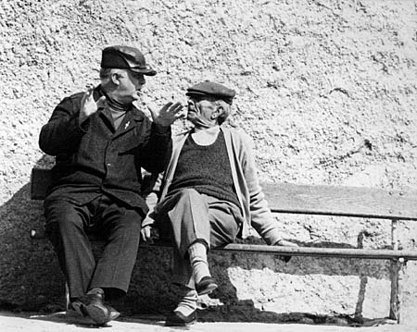
Active Listening: Helpful Tool
Converse
Build relationships
Discover new ideas
Solve problems
Practice!
Notes:
It’s a tool just like audience analysis, research, graphics, and outlining.
- It encourages conversations and helps build relationships -- with customers, colleagues and management.
- It helps you discover new ideas – accurate ideas about who’s interested in your product idea and how interested they are.
- It can help you solve problems – ex., you may tweak your product idea based on feedback you heard in customer conversations.
- As with any tool, you can only get better at active listening by practicing. And, best of all, active listening helps us with bosses, colleagues, suppliers, regulators – and customers.

Slide 13
New Project? Have a Research Plan that includes talking with customers.

Slide 14
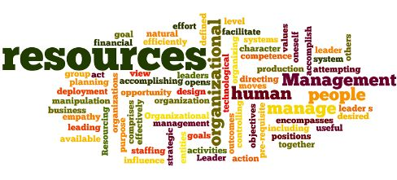
References
Alred, G.J., Brusaw, C.T., and Oliu, W.E. (2014). The Business Writer’s Companion (7th ed.), Boston: Bedford.
Clark, N.F. (2012). “10 Steps to Effective Listening.” Forbes. Retrieved from https://www.forbes.com/sites/womensmedia/2012/11/09/10-steps-to-effective-listening/#1c15d0a73891
Institute of Judicial Studies. (2013). “Handout 1: Albert Mehrabian Communication Studies.” Retrieved from http://www.iojt-dc2013.org/~/media/Microsites/Files/IOJT/11042013-Albert-Mehrabian-Communication-Studies.ashx.
Institute of Judicial Studies. (2013). “Handout 2: Active Listening Skills.” Retrieved from http://www.iojt-dc2013.org/~/media/Microsites/Files/IOJT/11042013-Albert-Mehrabian-Communication-Studies.ashx.
National Aeronautics & Space Administration. (2008). Spinoff: 50 Years of NASA-Driven Technologies (1958-2008), 6. Retrieved from https://spinoff.nasa.gov/Spinoff2008/pdf/spinoff2008.pdf.
APA Style (American Psychological Association)
See Blackboard, OWL website

Slide 15
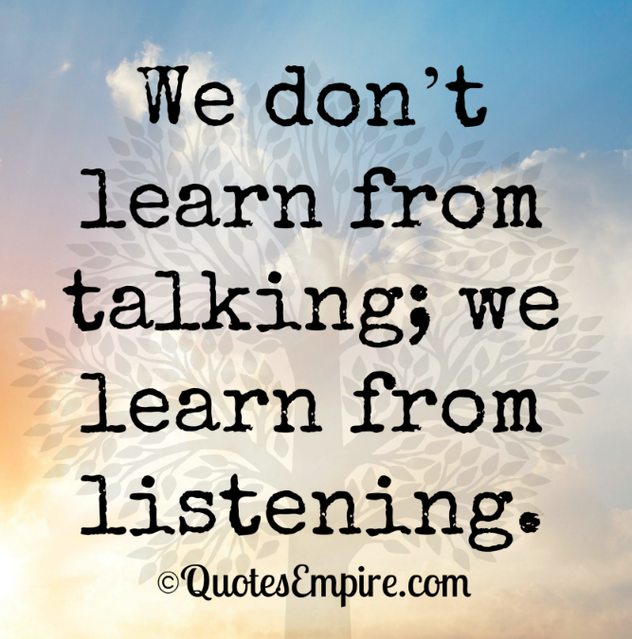
Q&A

